Slide 1
UNIQ+ Introduction to R Day 2 – Into the Tidyverse
Friday 12th July
Micah Fletcher

Slide 2
Housekeeping
Fire exits
All course materials
https://github.com/micahpf/UNIQplus_R_Course_2025
Click big green button “Code” > “Download ZIP”
Ask questions!
Use Etherpad to discuss during and after the course
Code along with us
Group work for some practicals
Not meant to be an exhaustive course on R (impossible in this time) – rather, we are trying to teach how to learn R
Attendance

Slide 3
Course Overview
Thursday 10th July - R Fundamentals
Morning - Introduction to R
Session 1.1 - 9:30-10:15 - R & RStudio
Session 1.2 - 10:20-11:00 - Data structures
Tea/Coffee - 11:00-11:15
Session 1.3 - 11:15-12:30 - Conditionals & Loops
Lunch - 12:30-13:30
Afternoon - Exploring data
Session 1.4 - 13:30-14:30 – I/O, tabular data, plotting basics
Session 1.5 - 14:45-15:30 – Matrices & more plotting
Session 1.6 - 15:45-16:30 – Choose your own adventure
Friday 11th July - Into the Tidyverse
Morning - Advanced plotting and data wrangling
Session 2.1 - 9:30-10:15 – Packages & ggplot2
Session 2.2 - 10:20-11:00 – tidyverse basics
Tea/Coffee - 11:00-11:15
Session 2.3 - 11:15-12:30 – Reshaping data
Lunch - 12:30-13:30
Afternoon - Reproducible research
Session 2.4 - 13:30-14:30 – R Projects, paths, R Markdown
Session 2.5 - 14:45-15:30 – Exploratory data analysis Session 2.6 - 14:45-15:30 – More Exploratory data analysis

Slide 4
2.1 - Packages & ggplot2
Outline
Packages: Installing & loading
Plotting with ggplot2
Geometries, aesthetics
Facets
Exercise

Slide 5
2.1 – Packages & Repositories
What are packages?
Packages are code written by other people
There are several pre-installed R packages, e.g. base, stats, datasets, that comprise “base R”
Extend functionality of base R (i.e. “expansion packs” or “mods” for R)
Contain new functions, new data classes, example datasets, help documentation, “vignettes”
Version controlled and handle dependencies on additional packages

Slide 6
2.1 – Packages & Repositories
Packages are code written by other people
There are several pre-installed R packages, e.g. base, stats, datasets, that comprise “base R”
Extend functionality of base R (i.e. “expansion packs” or “mods” for R)
Contain new functions, new data classes, example datasets, help documentation, “vignettes”
Version controlled and handle dependencies on additional packages

Slide 7
2.1 – Packages & Repositories
Package “repositories”
Websites that collect package code for users to download
Require good documentation, error checks, and compatibility with R versions and OS
Examples:
Comprehensive R Archive Network (CRAN) – most packages live here
Bioconductor – many bioinformatics-specific packages live here
GitHub – less rigorously vetted or more unstable packages (use caution!)

Slide 8
2.1 – Installing & Loading Packages
Installing CRAN Packages
> install.packages(“ggplot2”)
Loading Packages
> library(ggplot2)

Slide 9
2.1 – Installing & Loading Packages
Installing Bioconductor or GitHub packages requires helper packages
Bioconductor:
> install.packages(“BiocManager”)
> BiocManager::install(“edgeR”)
Github:
> install.packages(“remotes”)
> remotes::install_github(“satijalab/seurat-data”)

Slide 10
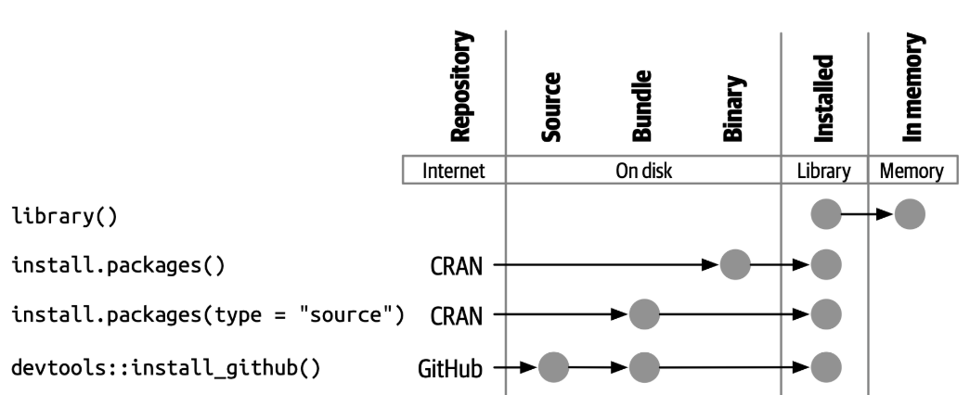
2.1 – Installing & Loading Packages – Source vs Binaries
Package – A set of executable code comprised of functions, documentation, vignettes etc.
Library – Directory with decompressed executable binary packages
Binary – System-dependent executable binary package
Source – System-agnostic source code of package, needs to be “built” into a binary package using system-dependent compilers.
Repository – Location on internet where package sources and binaries can be downloaded
library()
library()
install.packages()
install.packages(type = source)
remotes::install_github()

Slide 11
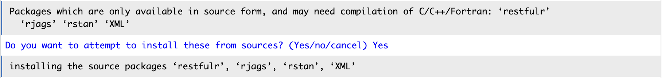
2.1 – Installing & Loading Packages – Source vs Binaries
Package – A set of executable code comprised of functions, documentation, vignettes etc.
Library – Directory with decompressed executable binary packages
Binary – System-dependent executable binary package
Source – System-agnostic source code of package, needs to be “built” into a binary package using system-dependent compilers.
Repository – Location on internet where package sources and binaries can be downloaded
Most commonly used CRAN packages can and should be installed from binary on Windows or Mac.
Installing from source is prone to error if your compilers are not set up properly.
However, some packages (or package dependencies) are only available in source form:

Slide 12
2.1 – Installing & Loading Packages – Conflicting function names
Sometimes more than one package have the same function name.
The package loaded last “masks” the function names from any previously loaded packages.
For example, the “stats” package and “dplyr” package both have a function called “filter”.
The stats package is loaded by default, so after running library(dplyr), R will assume that we want to use the filter from the dplyr package instead of the stats package.
We can specify which package we intend to use by using the :: notation:
> stats::filter
> dplyr::filter

Slide 13
2.1 – Plotting with ggplot2
ggplot2 is a package for plotting is based on “The Grammar of Graphics”
Once you learn the grammar, you can quickly create complex, beautiful, multi-variable plots!
Decomposes graphics into layers:
Data, Mapping, Statistics, Scales, Geometries, etc…
Most basic/important layers: data, mapping (aesthetics) & geometry.
data
A data frame
mapping
Which columns to ”map” to “aesthetics” like x, y, color, size, etc.
geometry
What type of plot to draw using the provided “aesthetics”
theme
Overall appearance and inclusion/exclusion of plot elements
ggplot(data = …, mapping = aes()) + geom_point() + theme()
Theme
Geometry
Mapping
Data

Slide 14
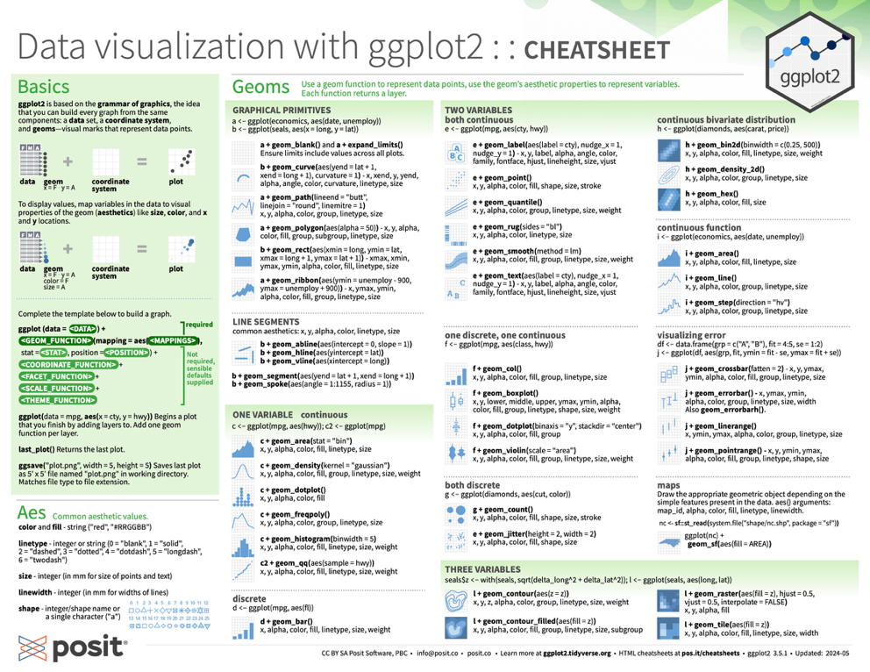
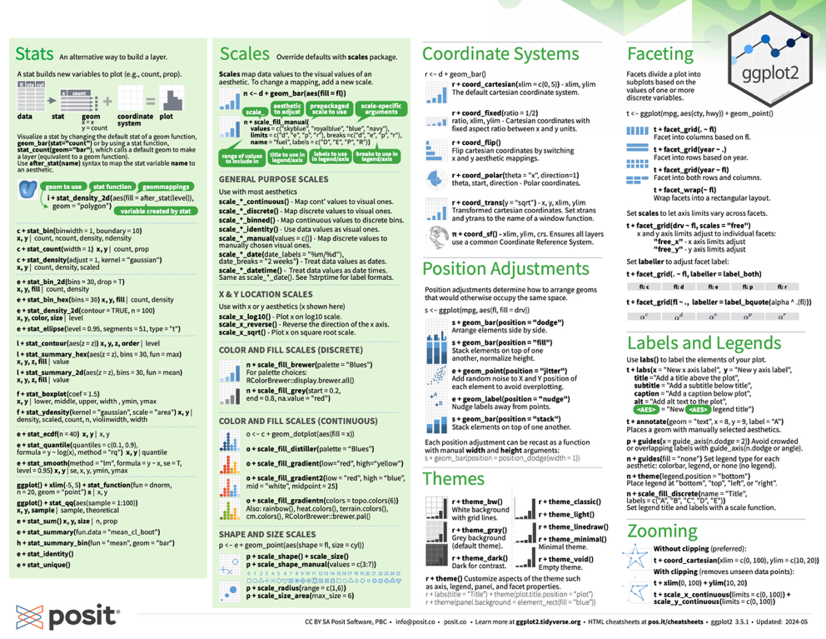
2.1 – Plotting with ggplot2 - resources
Simple vignette
> vignette(“ggplot2”)
Cheat sheet
https://rstudio.github.io/cheatsheets/data-visualization.pdf
R for Data Science, Ch 1, 9-11
https://r4ds.hadley.nz/
Inspo & recipes
https://r-graph-gallery.com/

Slide 15

Let´s practice!
Image by lucabravo on Freepik

Slide 16
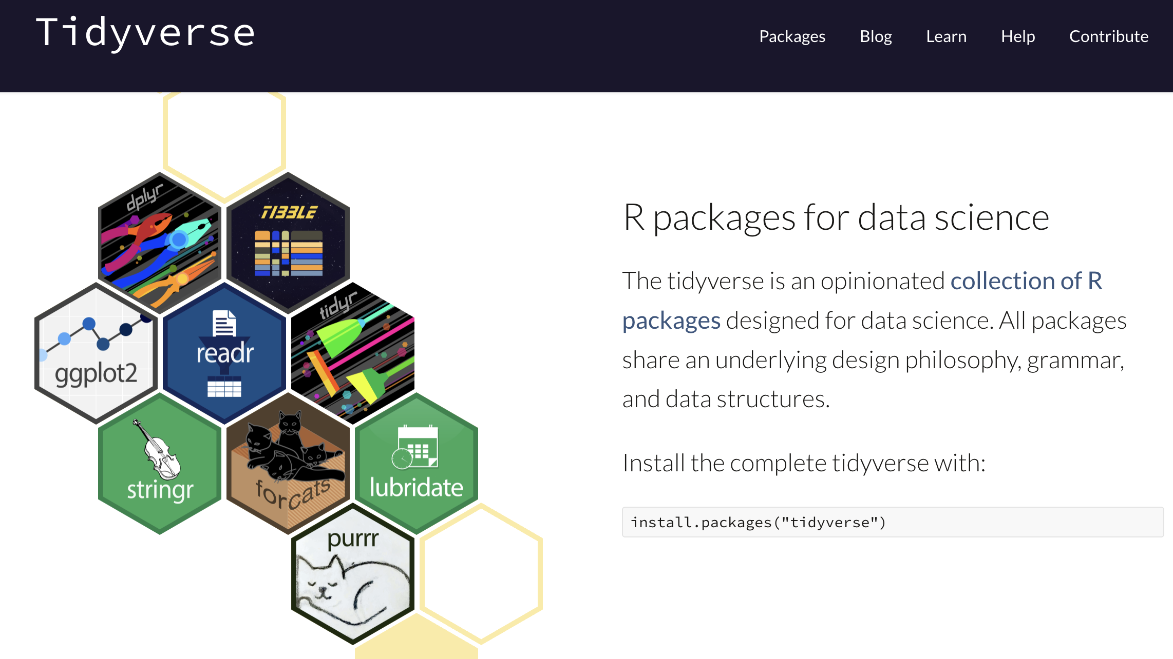
https://www.tidyverse.org/

Slide 17

2.2 – What is “tidy” data?
Each variable is a column; each column is a variable.
Each observation is a row; each row is an observation.
Each value is a cell;
each cell is a single value.
A consistent data format -> coherent set of “verbs” for manipulation
Each variable if a column -> columns are vectors -> R operates efficiently on vectors

Slide 18
2.2 – dplyr: data transformation “verbs”
dplyr is a package for data manipulation in a declarative style
The key functions are “verbs” with a common design philosophy:
The first argument is a data frame
The subsequent arguments specify how you want to change the column or row
The output is always a data frame
You can also use |> “pipe” to string together multiple verbs in a single line
A |> function(B) becomes function(A, B)
Note: %>% was introduced as part of the tidyverse before |> was added to base R. They are largely interchangeable

Slide 19
2.2 – dplyr: data transformation “verbs”
Manipulate cases (i.e. rows)
mtcars |> filter(cyl == 4)
mtcars |> distinct(cyl)
mtcars |> slice(1:5)
Manipulate variables (i.e. columns)
mtcars |> mutate(mpg_uk = mpg*1.201)
mtcars |> rename(mpg_us = mpg)
mtcars |> select(mpg, cyl)
mtcars |> pull(mpg)
Summarise cases
mtcars |> summarise(avg = mean(mpg))
mtcars |> count(cyl)
Group cases
avg_mpg_tbl <- mtcars |> group_by(cyl) |> summarize(avg = mean(mpg))
avg_mpg_tbl |> ungroup()

Slide 20
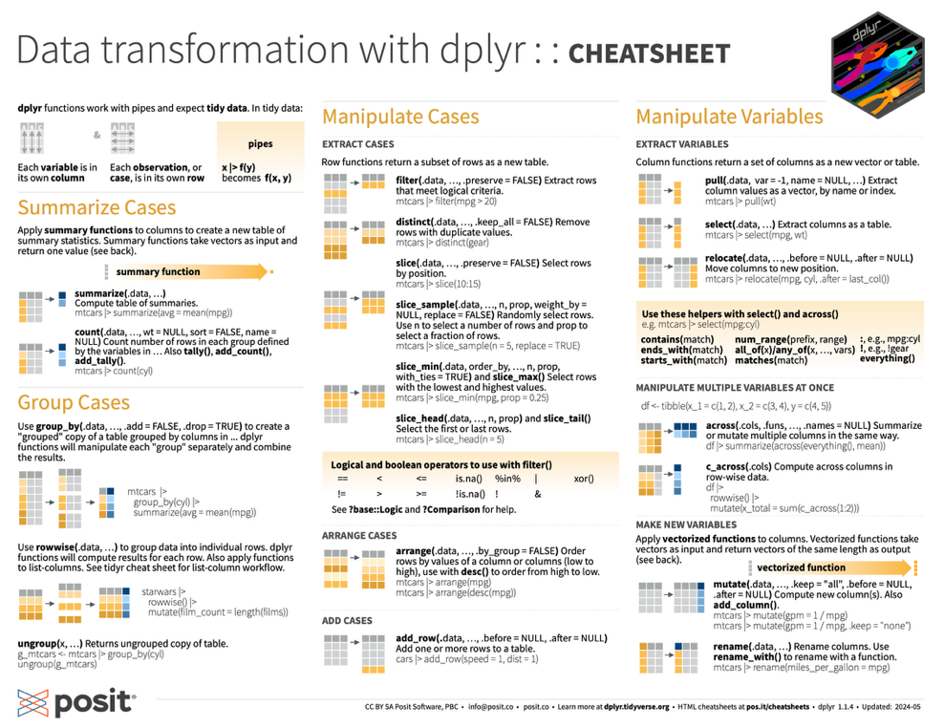
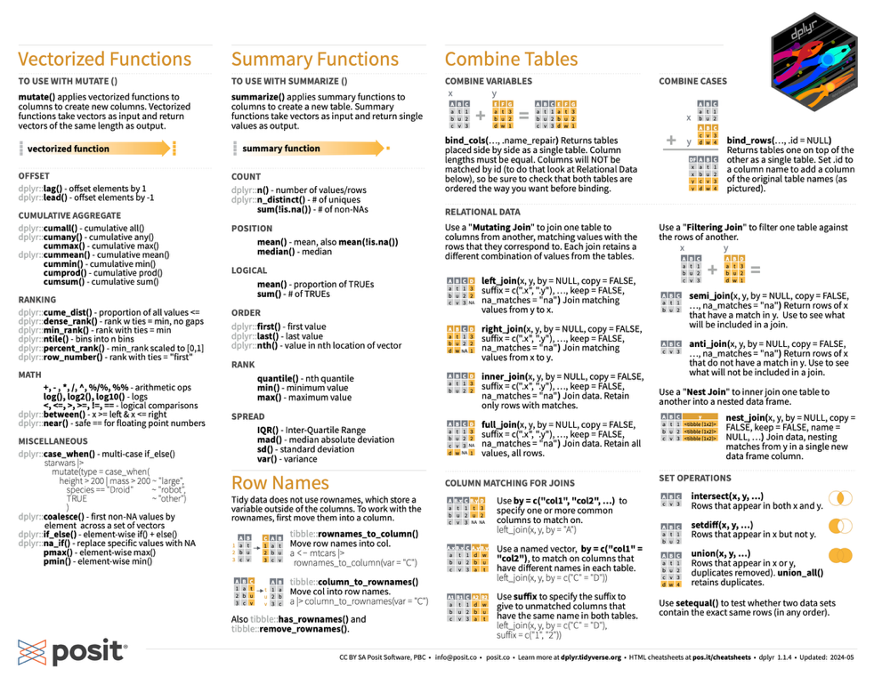
2.2 – dplyr: data transformation - resources
R for Data Science, Ch 3, 12-19
https://r4ds.hadley.nz/
Dplyr vignette
> vignette("dplyr")
Cheat sheet
https://rstudio.github.io/cheatsheets/data-transformation.pdf

Slide 21
Let´s practice!
Image by lucabravo on Freepik

Slide 22
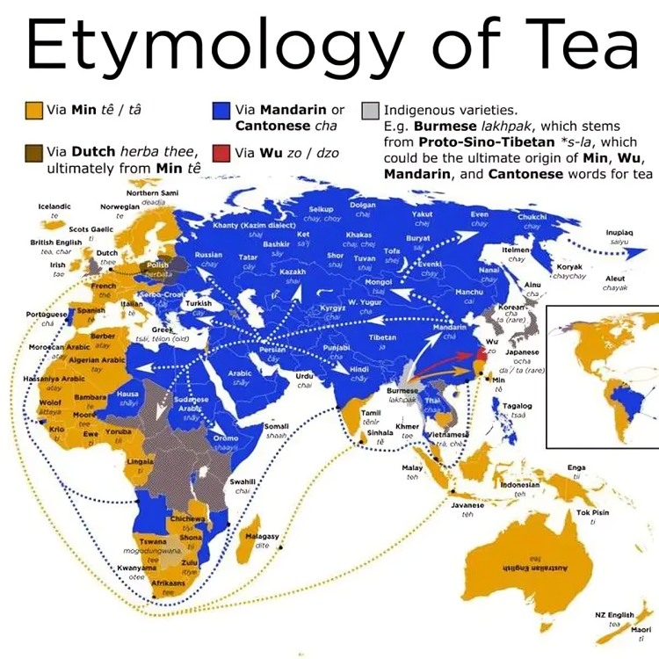

Slide 23
2.3 – Making data tidy:
Each variable is a column; each column is a variable.
Each observation is a row; each row is an observation.
Each value is a cell;
each cell is a single value.
A consistent data format -> coherent set of “verbs” for manipulation
Each variable if a column -> columns are vectors -> R operates efficiently on vectors

Slide 24
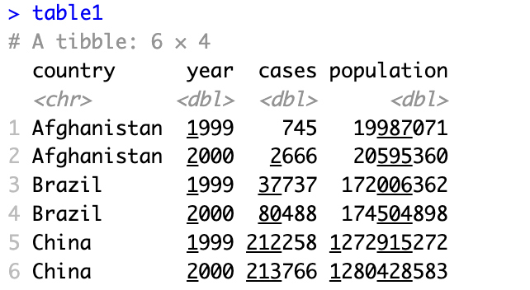
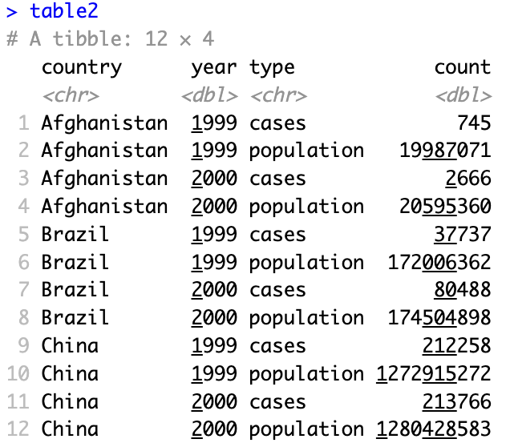
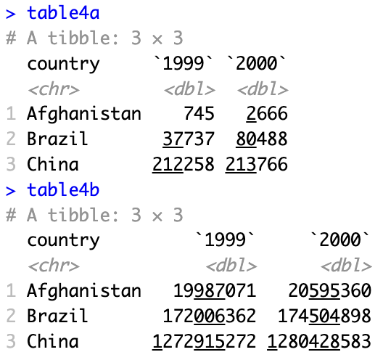
2.3 – Making data tidy
Each column is a variable,
each row is a observation
”type” includes labels for the values in “count”
The year variable is split across columns, cases and population are separate tables
Tidy
Long
Two wide tables
Need to “pivot wider”
Need to “pivot longer” and “join”

Slide 25
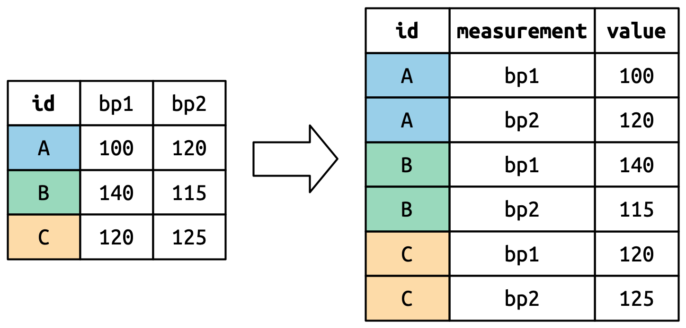
2.3 – Making data tidy – pivoting longer
df, |> pivot_longer(cols = bp1:bp2, names_to = “measurement”, values_to = “value”)
https://r4ds.hadley.nz/data-tidy.html#how-does-pivoting-work

Slide 26
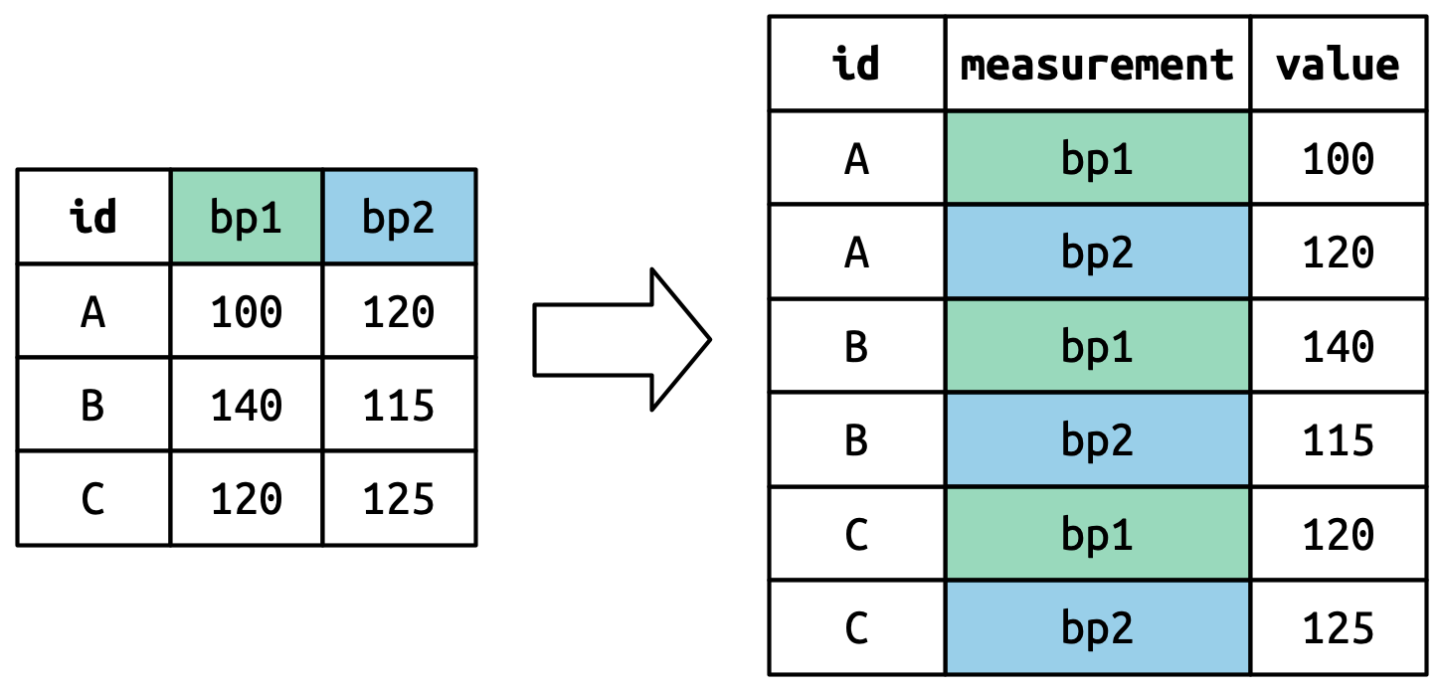
2.3 – Making data tidy – pivoting longer
df, |> pivot_longer(cols = bp1:bp2, names_to = “measurement”, values_to = “value”)
https://r4ds.hadley.nz/data-tidy.html#how-does-pivoting-work

Slide 27
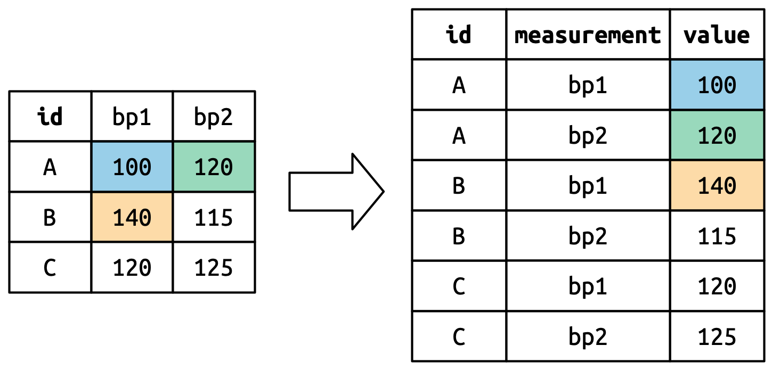
2.3 – Making data tidy – pivoting longer
df, |> pivot_longer(cols = bp1:bp2, names_to = “measurement”, values_to = “value”)
https://r4ds.hadley.nz/data-tidy.html#how-does-pivoting-work

Slide 28
2.3 – Making data tidy – pivoting longer
df, |> pivot_longer(cols = bp1:bp2, names_to = “measurement”, values_to = “value”)
https://r4ds.hadley.nz/data-tidy.html#how-does-pivoting-work

Slide 29

2.3 – Making data tidy – pivoting longer
table2 |> pivot_wider(names_from = type, values_from = count)

Slide 30
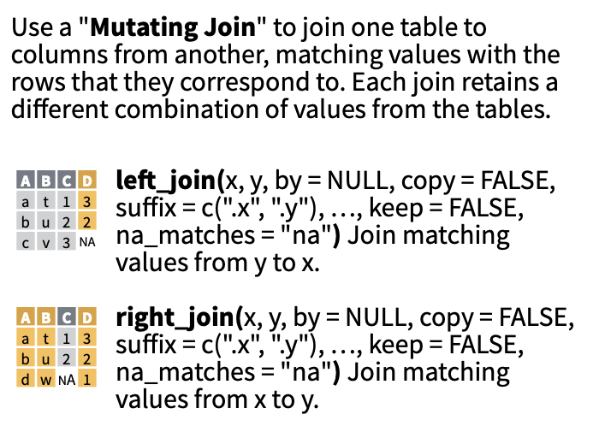
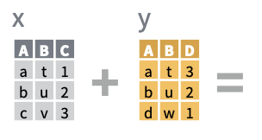
2.3 – Combining data – mutating joins
https://rstudio.github.io/cheatsheets/data-transformation.pdf

Slide 31
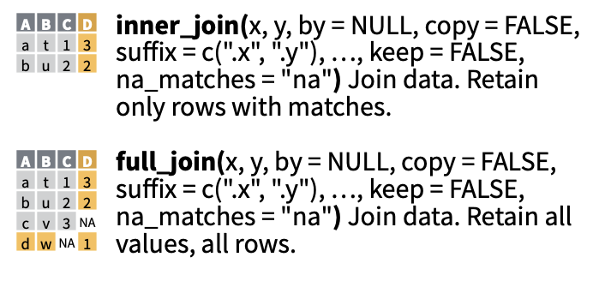
2.3 – Combining data – mutating joins
https://rstudio.github.io/cheatsheets/data-transformation.pdf

Slide 32
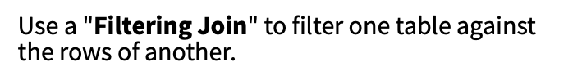
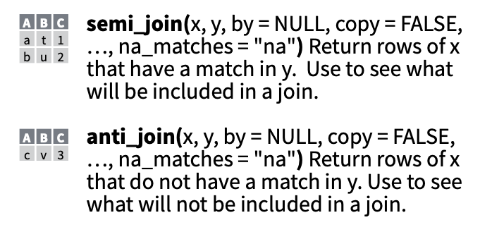
2.3 – Combining data – filtering joins
https://rstudio.github.io/cheatsheets/data-transformation.pdf

Slide 33
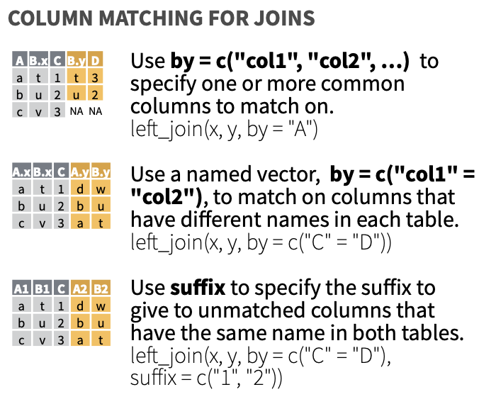
2.3 – Combining data – Column matching for joins
https://rstudio.github.io/cheatsheets/data-transformation.pdf

Slide 34
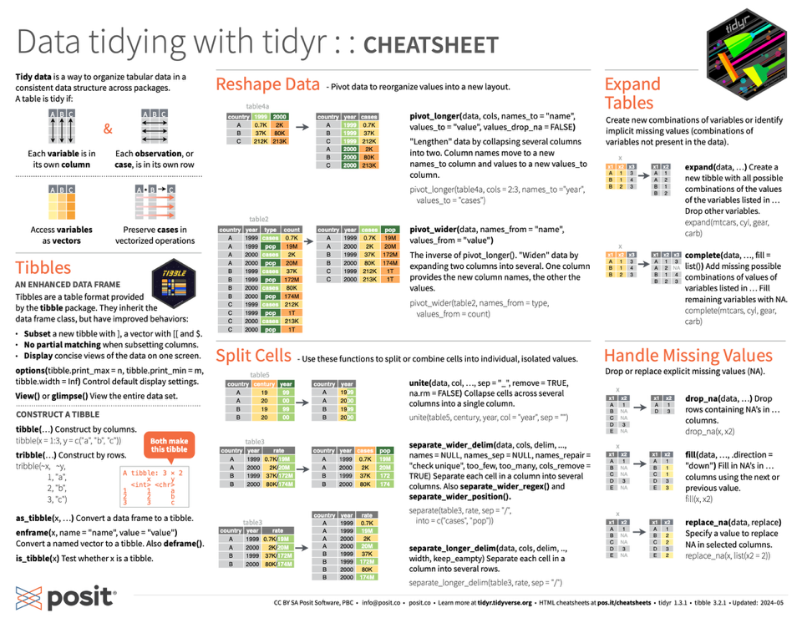
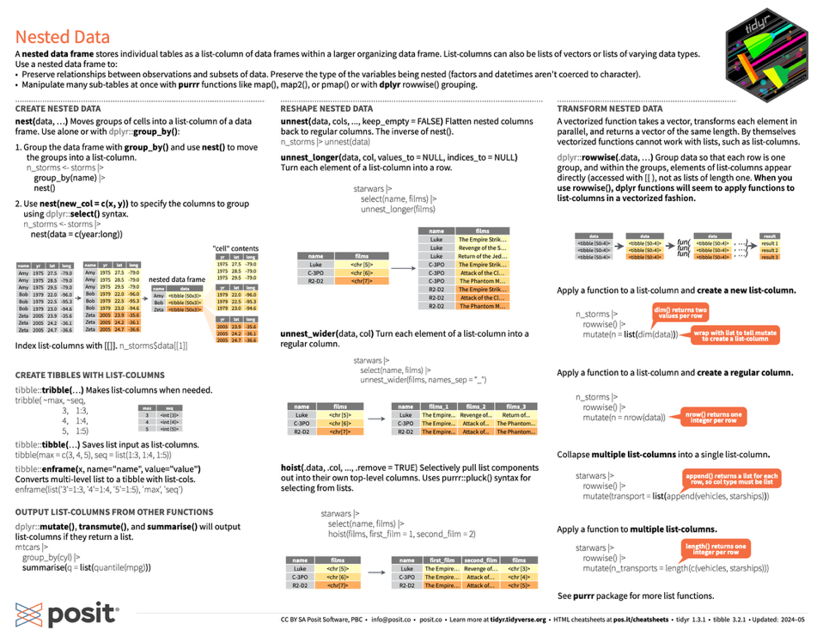
2.3 – Data tidying & combining data - resources
R for Data Science, Ch 3, 12-19
https://r4ds.hadley.nz/
Cheat sheet for pivots (for joining, see dplyr cheat sheet)
https://rstudio.github.io/cheatsheets/tidyr.pdf
Pivoting vignette
> vignette("pivot")
Joining vignette
> vignette(”two-table")

Slide 35
Let´s practice!
Image by lucabravo on Freepik

Slide 36
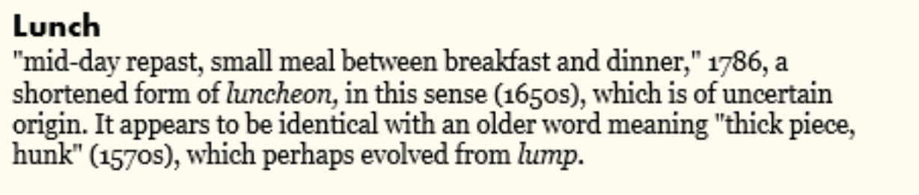

Slide 37
Course Overview
Thursday 10th July - R Fundamentals
Morning - Introduction to R
Session 1.1 - 9:30-10:15 - R & RStudio
Session 1.2 - 10:20-11:00 - Data structures
Tea/Coffee - 11:00-11:15
Session 1.3 - 11:15-12:30 - Conditionals & Loops
Lunch - 12:30-13:30
Afternoon - Exploring data
Session 1.4 - 13:30-14:30 – I/O, tabular data, plotting basics
Session 1.5 - 14:45-15:30 – Matrices & more plotting
Session 1.6 - 15:45-16:30 – Choose your own adventure
Friday 11th July - Into the Tidyverse
Morning - Advanced plotting and data wrangling
Session 2.1 - 9:30-10:15 – Packages & ggplot2
Session 2.2 - 10:20-11:00 – tidyverse basics
Tea/Coffee - 11:00-11:15
Session 2.3 - 11:15-12:30 – Reshaping data
Lunch - 12:30-13:30
Afternoon - Reproducible research
Session 2.4 - 13:30-14:30 – R Projects, paths, RMarkdown
Session 2.5 - 14:45-15:30 – Exploratory data analysis Session 2.6 - 14:45-15:30 – More Exploratory data analysis

Slide 38
2.3 – Reproducible research
Will you be able to reproduce the same result tomorrow? A month from now?
Will you be able to make changes after your supervisor gives you feedback?
Will the journal accept your paper?
Key to reproducibility:
Rstudio Projects - Keeping data, code, prose explanations, outputs organized
R Markdown - Intelligible scripts that flow from raw data to final outputs
git and GitHub - Version control and code backups (beyond scope of this course)
but this is a great intro: https://www.epirhandbook.com/en/new_pages/collaboration.html

Slide 39
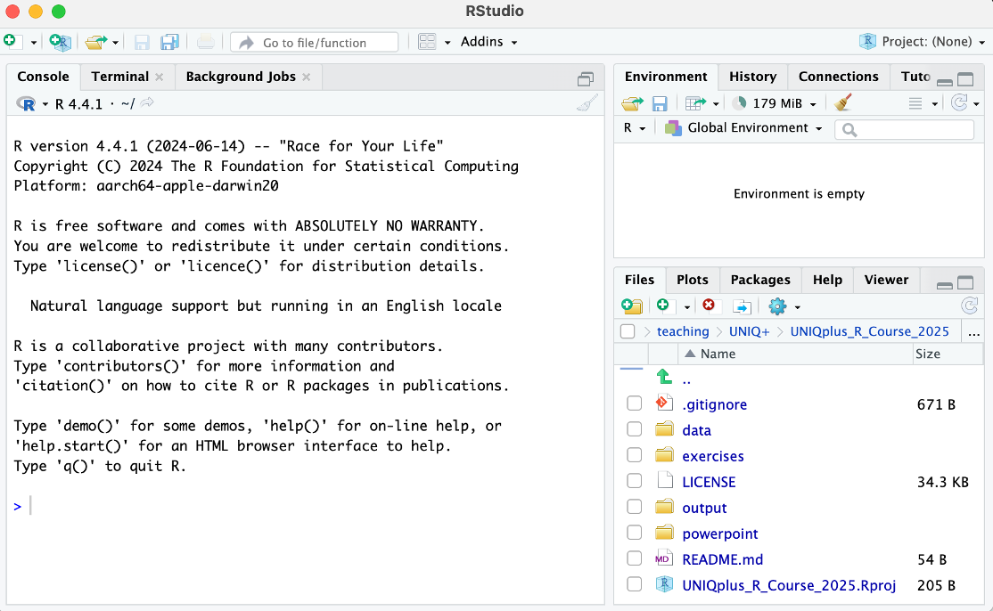
2.3 – Reproducible research – RStudio Projects
RStudio Projects:
Present working directory = project root directory
Never change working directory
Use relative paths with here::here()
Can save R history

Slide 40
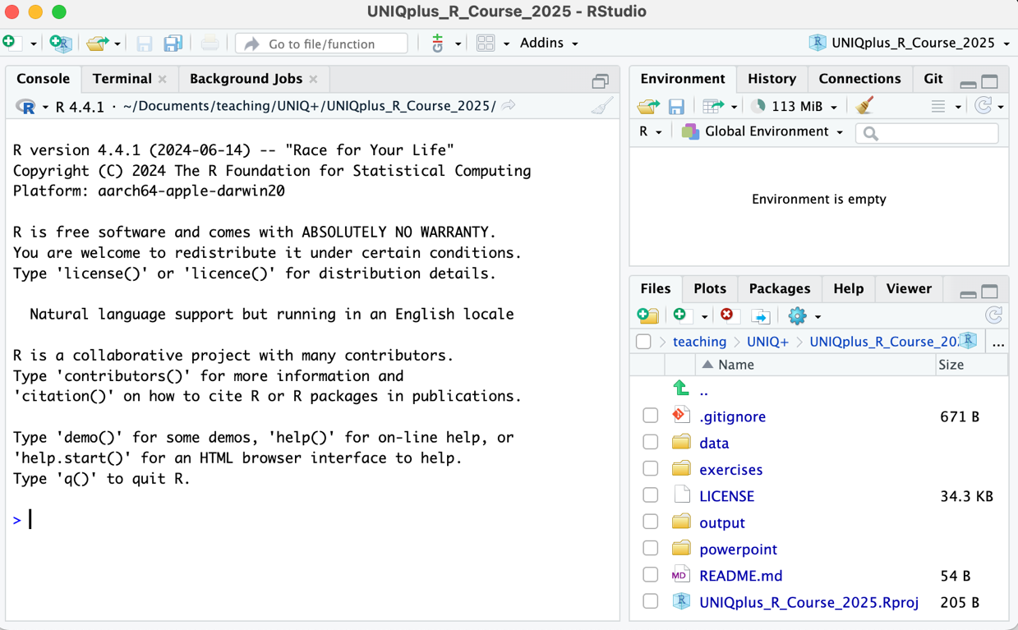
2.3 – Reproducible research – RStudio Projects
RStudio Projects:
Present working directory = project root directory
Can save R history
Never need to change working directory
Use relative paths with here::here()

Slide 41

2.3 – Reproducible research – here()
here::here() uses the .Rproj file to convert relative paths to absolute paths
Illustration by Allison Horst

Slide 42
2.3 – Reproducible research – here()
here::here() uses the .Rproj file to convert relative paths to absolute paths
For example:
> library(here)
here() starts at /Users/micahf/Documents/teaching/UNIQ+/UNIQplus_R_Course_2025
> here(“data/nyc_squirrel_uniq_plus.csv”)
"/Users/micahf/Documents/teaching/UNIQ+/UNIQplus_R_Course_2025/data/nyc_squirrel_uniq_plus.csv"
In scripts, set relative paths within your project so it won’t be dependent on where your project is located
You or a collaborator can work on a copy of the same project on another computer
This keeps code tidy and is crucial when using git/GitHub collaboratively

Slide 43
2.3 – Reproducible research – R Markdown
Easy way to combine:
Plain text
Code
Data analysis (plots & tables)
Hyperlinks
…into a single nicely formatted and reproducible document

Slide 44
2.3 – Reproducible research – R Markdown
Why?
Transparency
Reproducibility (links your data with your R code)
You can create a variety of output formats
Increases efficiency if something needs to be changed

Slide 45
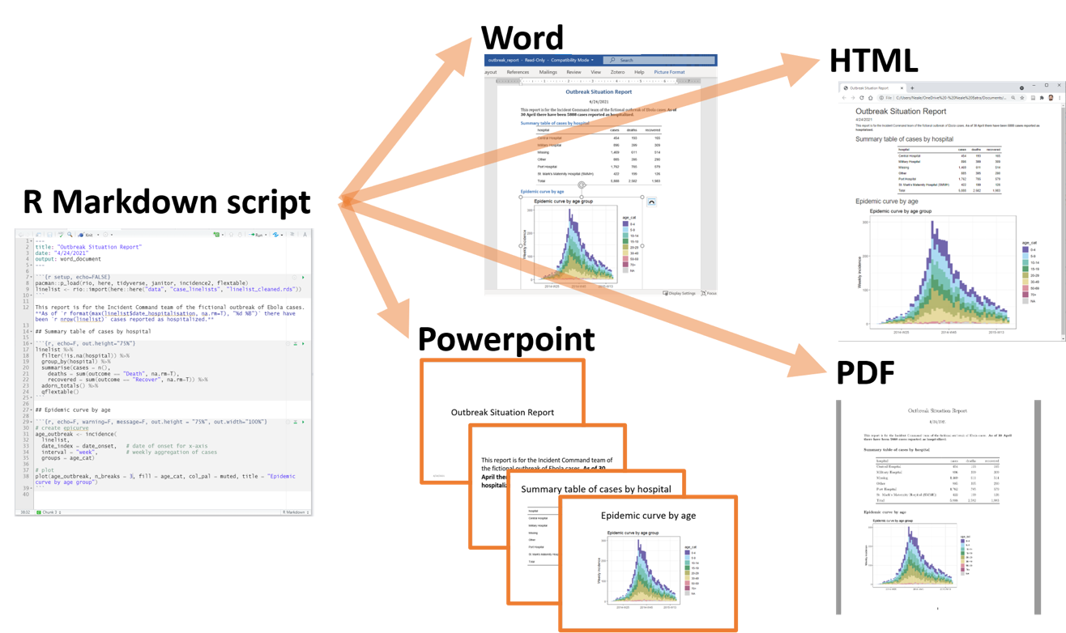
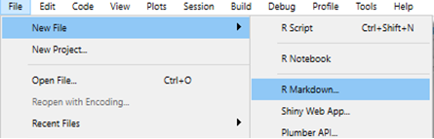
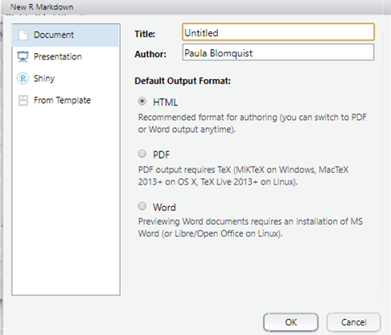
2.3 – Reproducible research – R Markdown
https://www.epirhandbook.com/en/new_pages/rmarkdown.html

Slide 46
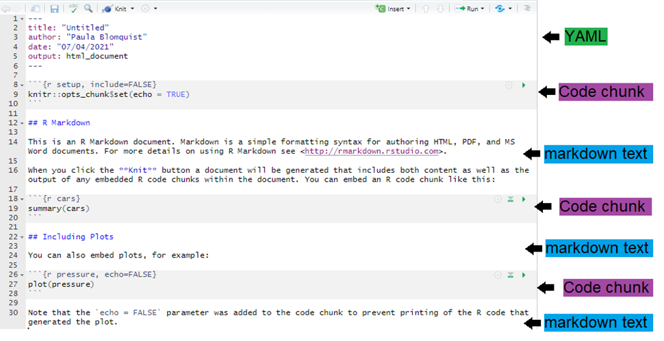
2.3 – Reproducible research – R Markdown
https://www.epirhandbook.com/en/new_pages/rmarkdown.html

Slide 47
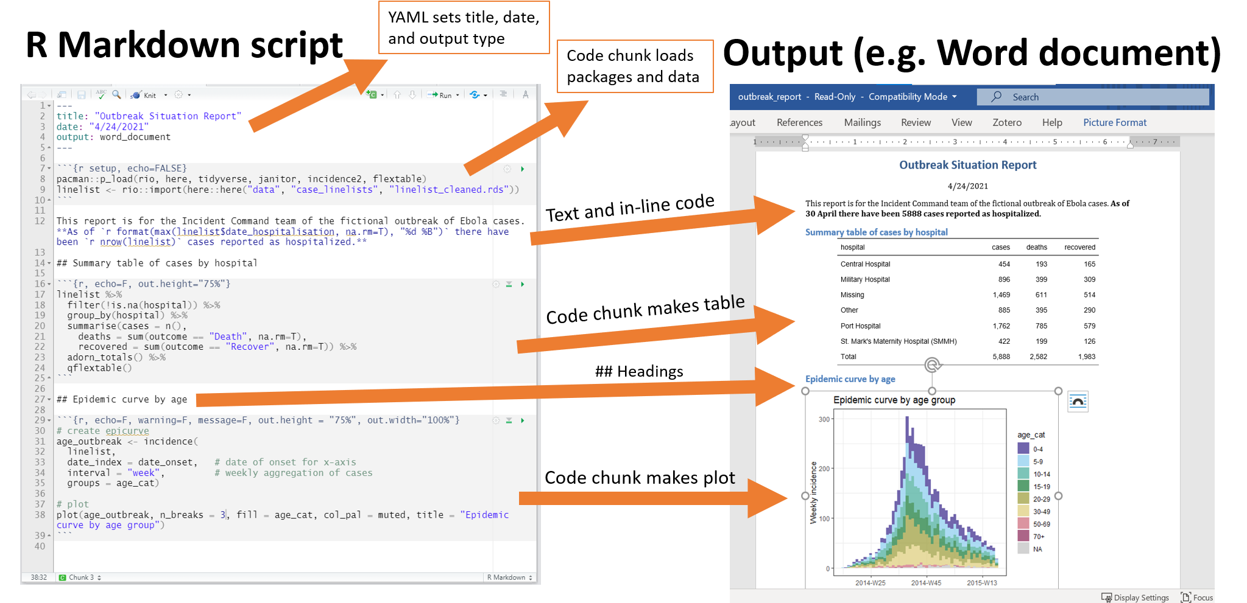
2.3 – Reproducible research – R Markdown
https://www.epirhandbook.com/en/new_pages/rmarkdown.html

Slide 48

2.3 – Reproducible research – R Markdown
How?

Slide 49
Let´s practice!
Image by lucabravo on Freepik

Slide 50

2.4 – Tidyverse - choose your own adventure!
Best Songs on Spotify from 2000-2023.csv
Song popularity, genre, sentiment analysis, etc.
Glassdoor Gender Pay Gap.csv
Job titles, pay, qualifications, gender, etc.
diabetes.csv
Potential correlates of diabetes
nyc_squirrel_uniq_plus.csv
Ethogram centered on activity and signals
penguins.csv
Body metrics across species, location, and years
us_births_2016_2021.csv
Parent ages, education, birth rate, weight, across States

